Slide 1
Practice: Programming for the Datapath (Week 5)

Slide 2
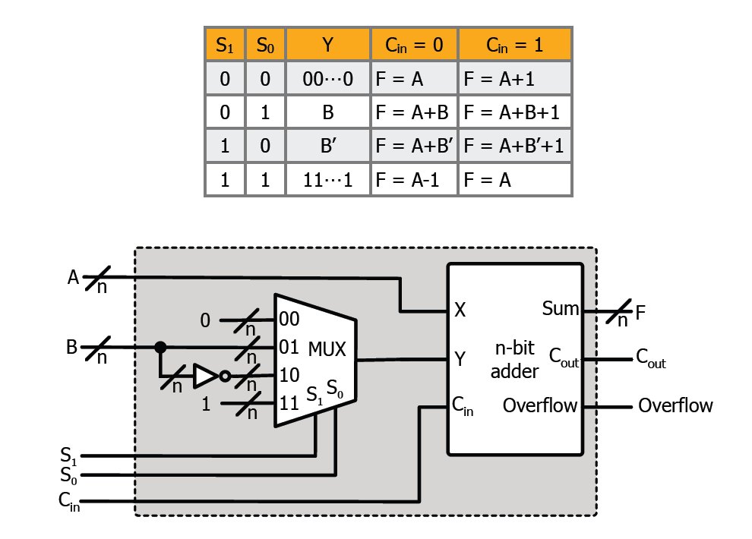
Arithmetic Unit

Slide 3
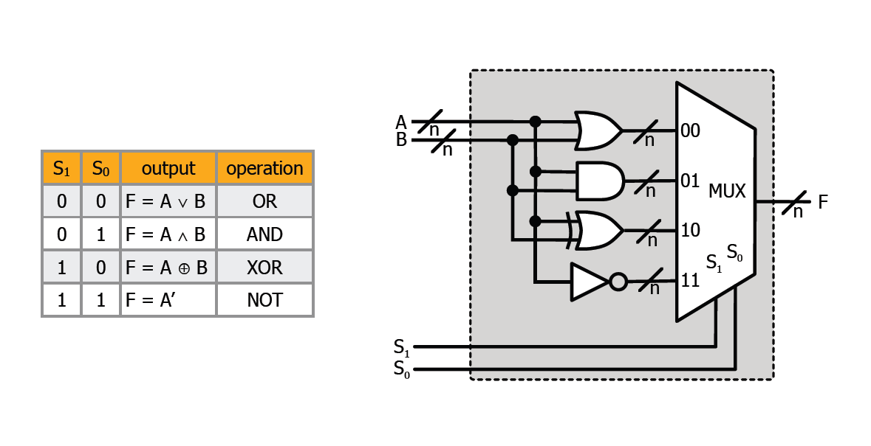
Logic Unit

Slide 4
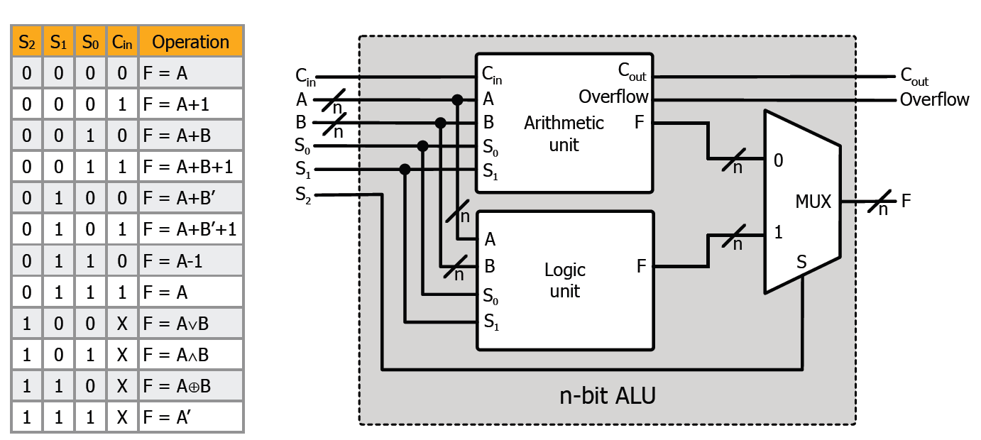
ALU
Arithmetic unit + logic unit

Slide 5
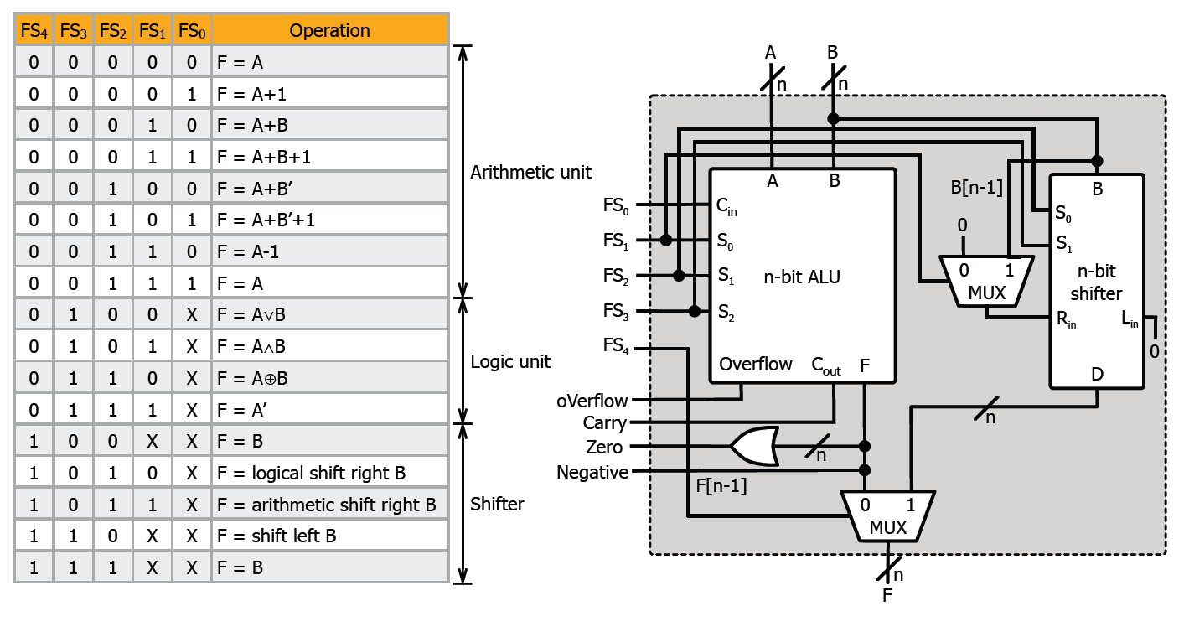
ALU in a Broader Sense
ALU + shifter

Slide 6
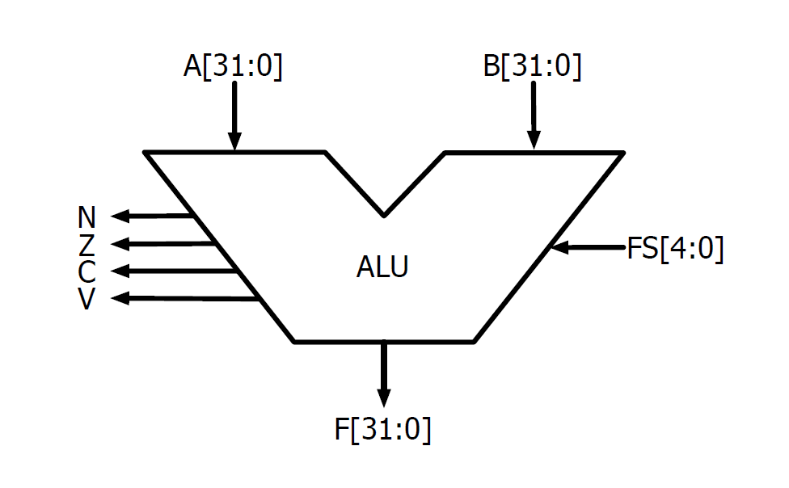
ALU Symbol

Slide 7
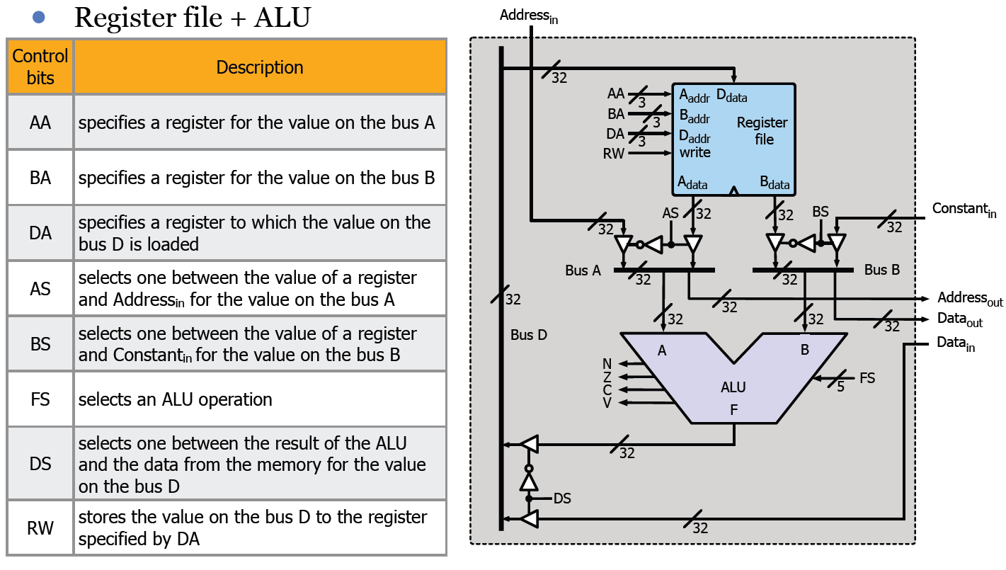
A 32-bit Datapath

Slide 8
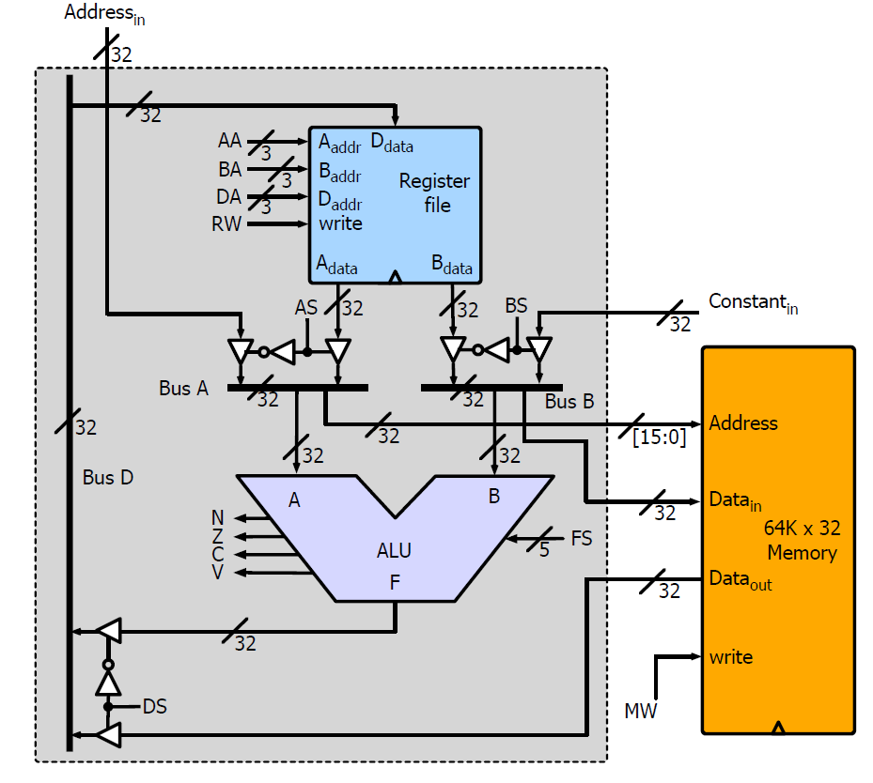
Attaching a Memory to the Datapath
16k

Slide 9
Register Transfer Language

Slide 10
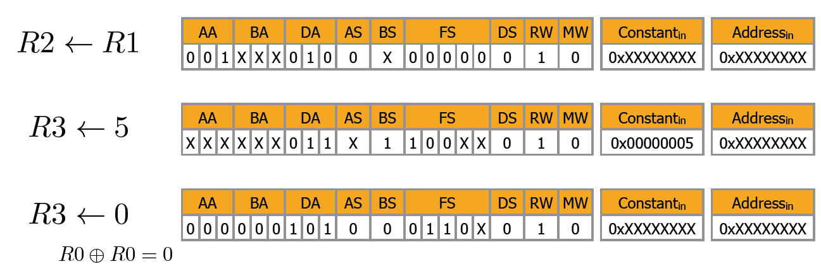
Register Transfer Language (RTL)

Slide 11
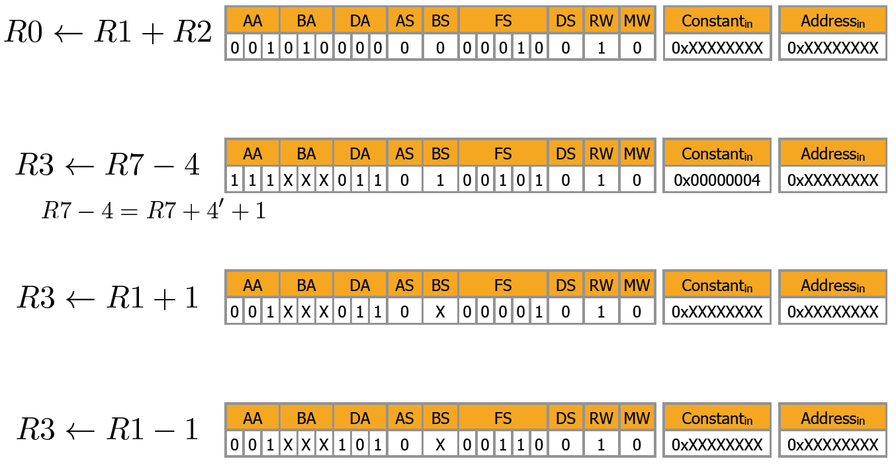
Register Transfer Language (RTL)

Slide 12
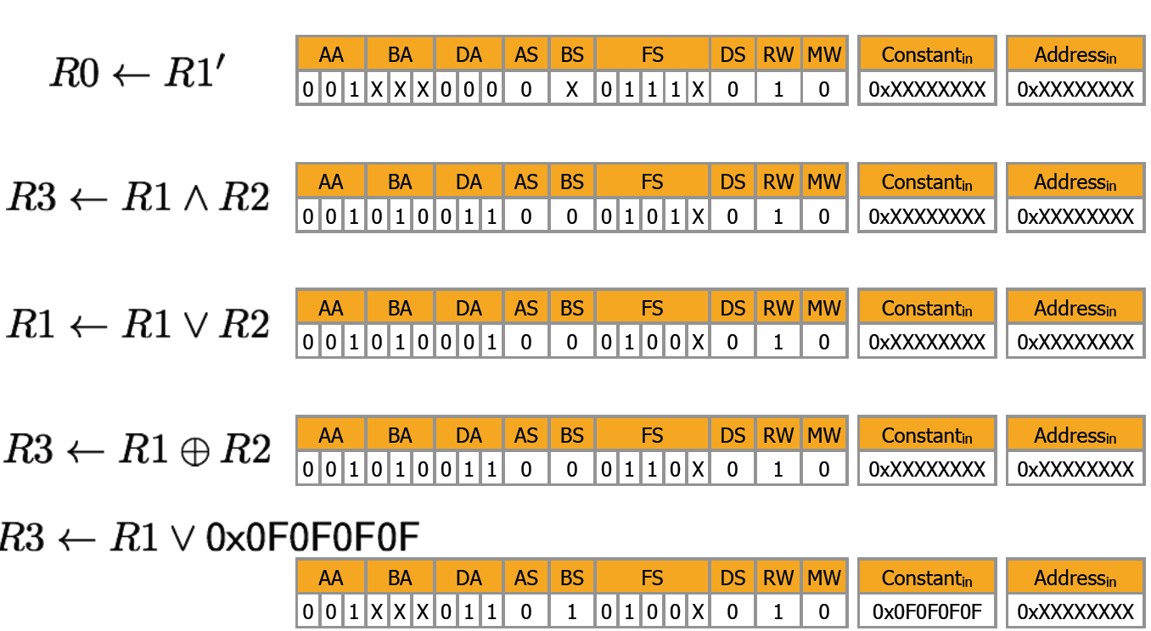
Register Transfer Language (RTL)

Slide 13
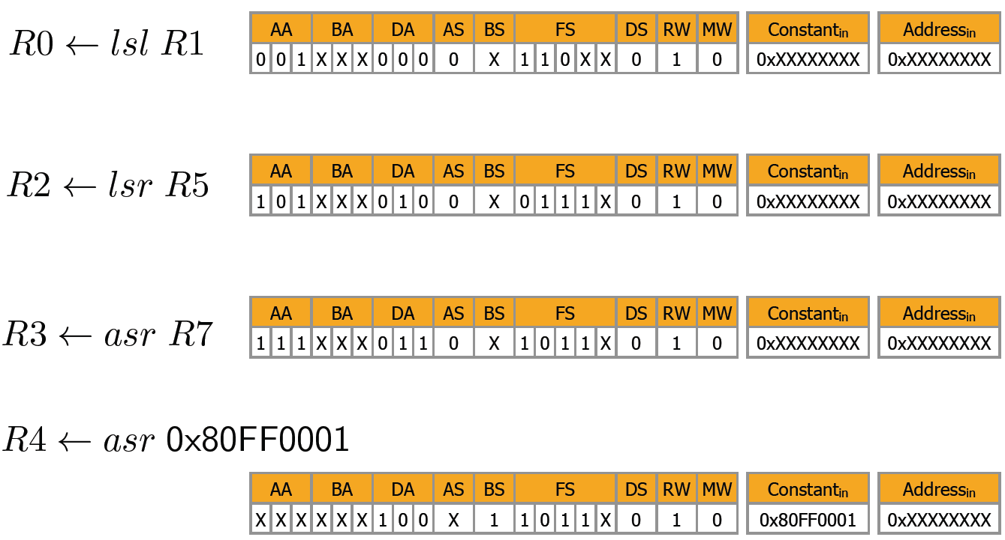
Register Transfer Language (RTL)

Slide 14
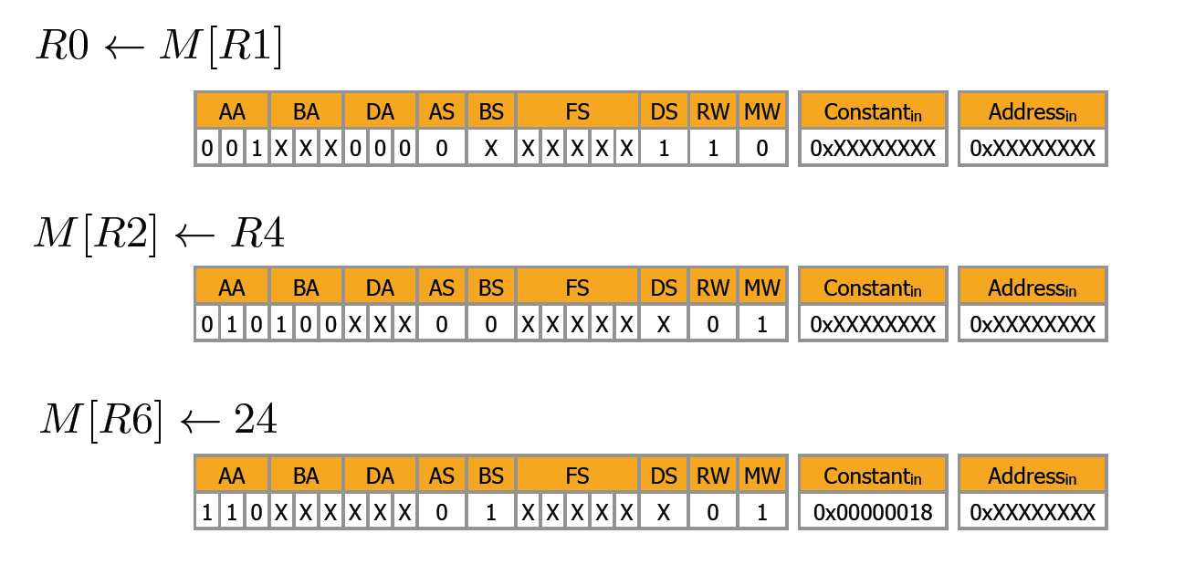
Register Transfer Language (RTL)

Slide 15
Programming the Datapath

Slide 16
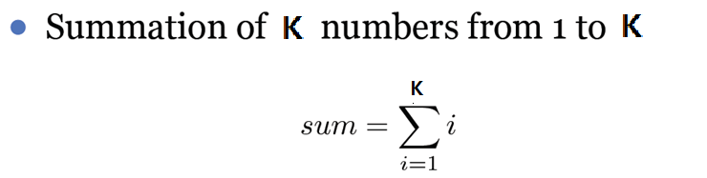
Summation of K numbers
Assume that k is 3.
At first write the RTL codes and then simulate your circuit

Slide 17
Fibonacci Numbers
The Fibonacci numbers are defined by,
0, 1, 1, 2, 3, 5, 8, 13, 21, 34, 55, 89, 144, 233, 377, …
Find 3th Fibonacci number.
At first write the RTL codes and then simulate your circuit

